Slide 1
Artificial Selection

Slide 2
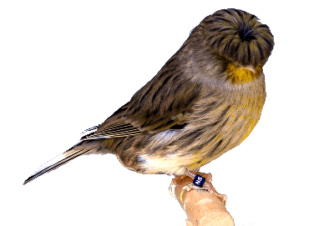
By the end of this lesson, you should be able to:
• | Understand how humans have used artificial selection.
• | Understand the problems of artificial selection.

Slide 3
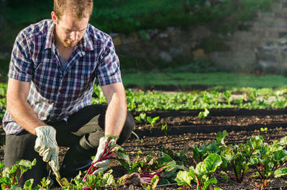
Humans have been domesticating animals and growing crops for a long time.
During this time, humans have learned to selectively breed plants and animals with the traits they find most desirable.
When humans intentionally breed plants or animals with certain desirable characteristics, this is known as artificial selection (or selective breeding).

Slide 4
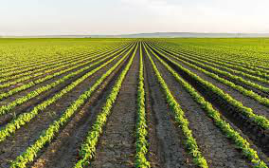
In artificial selection, organisms with undesirable traits are not allowed to breed.
Genetic diversity is decreased because only a small number of individuals with certain, desirable genes are selected to breed. Because of this, undesirable genes disappear from the gene pool.

Slide 5
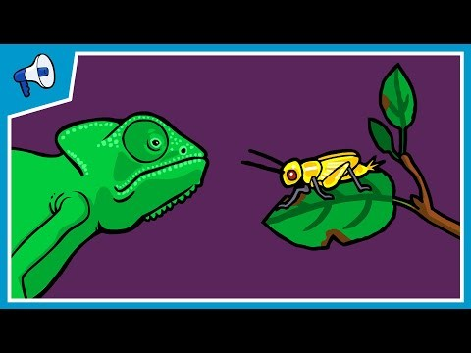

Slide 6
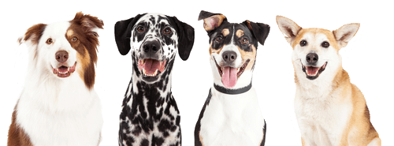
Here are the steps involved in selective breeding:
1. Choose parent organisms that show desired traits and breed them.
2. Choose the best offspring from these parents to breed the next generation.
3. Repeat the process across many generations. Over time, the desired traits will become more common.

Slide 7
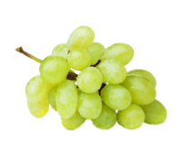
In many cases, artificial selection has produced a product perfectly matching human desires, such as large green leafy lettuces or grapes without seeds.
However, artificial selection can reduce genetic diversity of a species so much that were a disease to strike, most would die out due to the lack of variation in phenotypes.

Slide 8


Slide 9
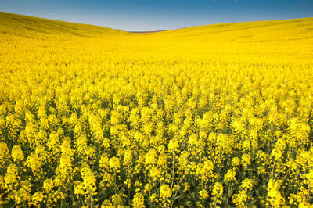
When a species with little variation in phenotypes, due to a lack of genetic diversity, is faced with disease or new environmental conditions, it is likely that the species will go extinct.
This is because the organisms are all very similar genetically.
It is likely none will possess a gene that may make them immune to the disease, so none will be able to survive to reproduce and pass on their genes.

